Slide 1
Graduate Research Symposium: growth of the IB
Oakland University
May 5, 2012

Slide 2
So what is the IB anyway?
Primary Years Program
Middle Years Program
Diploma Program

Slide 3
The IB Continuum
DP:
1968
MYP:
1994
PYP:
1997
Notes:
3
Presentation Title recommended size is 20 point Trebuchet, all caps.
Minimum Title size:18 point Trebuchet, all caps. Can be stacked in two lines if necessary.
Maximum Title size 24 point Trebuchet, all caps.

Slide 4
At the Core - The Learner Profile
Inquirers
Knowledgeable
Thinkers
Communicators
Principled
Open-minded
Caring
Risk-takers
Balanced
Reflective

Slide 5
Inquirers They develop their natural curiosity. They acquire the skills necessary to conduct inquiry and research and show independence in learning. They actively enjoy learning and this love of learning will be sustained throughout their lives.
Knowledgeable They explore concepts, ideas and issues that have local and global significance. In so doing, they acquire in-depth knowledge and develop understanding across a broad and balanced range of disciplines.
Thinkers They exercise initiative in applying thinking skills critically and creatively to recognize and approach complex problems, and make reasoned, ethical decisions.
Communicators They understand and express ideas and information confidently and creatively in more than one language and in a variety of modes of communication. They work effectively and willingly in collaboration with others.

Slide 6
Principled They act with integrity and honesty, with a strong sense of fairness, justice and respect for the dignity of the individual, groups and communities. They take responsibility for their own actions and the consequences that accompany them.
Open-minded They understand and appreciate their own cultures and personal histories, and are open to the perspectives, values and traditions of other individuals and communities. They are accustomed to seeking and evaluating a range of points of view, and are willing to grow from the experience.
Caring They show empathy, compassion and respect towards the needs and feelings of others. They have a personal commitment to service, and act to make a positive difference to the lives of others and to the environment.

Slide 7
Risk-takers They approach unfamiliar situations and uncertainty with courage and forethought, and have the independence of spirit to explore new roles, ideas and strategies. They are brave and articulate in defending their beliefs.
Balanced They understand the importance of intellectual, physical and emotional balance to achieve personal well-being for themselves and others.
Reflective They give thoughtful consideration to their own learning and experience. They are able to assess and understand their strengths and limitations in order to support their learning and personal development.

Slide 8
IB Americas
The IB Americas includes IB World Schools in 30 countries and territories in Central, North and South America. IB World Schools in the Americas are state/public, private, magnet, charter, international, parochial and secular and serve a broad and diverse range of students in urban, suburban and rural communities.
There are 476 schools providing the Primary Years Program in 18 countries, 666 providing the Middle Years Program in 18 countries and 1,215 providing the Diploma Program in 30 countries.

Slide 9
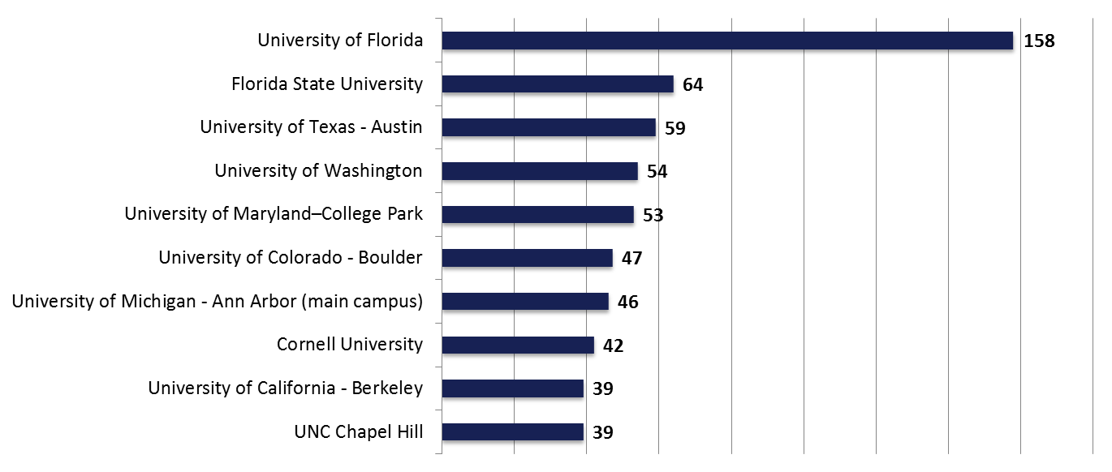
Where do IB students matriculate? U.S. - Top 10 Universities IB Students will be attending:
Base number: 3686

Slide 10
University or College | IB Candidates Acceptance Rate | Total Population Acceptance Rate | IB Candidates vs Total Population
University of Florida | 82% | 42% | +40%
Florida State University | 92% | 60% | +32%
Stanford University | 15% | 7% | +8%
University of California - Berkeley | 58% | 26% | +32%
New York University | 57% | 30% | +27%
University of Michigan - AA | 71% | 51% | +20%
University of Miami | 72% | 30% | +42%
Boston University | 70% | 58% | +12%
UCLA | 48% | 23% | +25%
University of Virginia | 64% | 32% | +32%
UNC Chapel Hill | 63% | 32% | +31%

Slide 11
U.S. – Acceptance Rate Comparisons
Institution | # of students applied | # of students accepted | IB student acceptance rate | General rate
Brown University | 218 | 38 | 17.4% | 8.7%
Columbia University | 221 | 30 | 13.6% | 6.9%
Cornell University | 190 | 60 | 31.6% | 18.0%
Dartmouth College | 88 | 15 | 17% | 9.7%
Duke University | 187 | 53 | 28.3% | 12.6%
Harvard University | 218 | 21 | 9.6% | 6.2%
Princeton University | 168 | 29 | 17.3% | 8.4%
Rice University | 102 | 39 | 38.2% | 18.6%
Stanford University | 229 | 35 | 15.3% | 7.1%
University of Pennsylvania | 190 | 47 | 24.7% | 12.3%
Yale University | 184 | 35 | 19% | 7.35%

Slide 12
Institution | % Admission | Base
Central Michigan | 100% | 17
Eastern Michigan | 100% | 4
Ferris State University | 100% | 3
Grand Valley State | 100% | 28
Hillsdale College | 100% | 7
Hope College | 100% | 4
Kalamazoo College | 100% | 11
Kettering University | 100% | 5
Lake Superior State | 100% | 1
Michigan Tech. | 100% | 10
U of M – Dearborn | 100% | 5
Western Michigan | 100% | 22
Michigan State | 95% | 87
Wayne State | 95% | 22
U of M – Ann Arbor | 71% | 190
U of M – Flint | 67% | 3
Northern Michigan | 67% | 3
Total |  | 422

Slide 13
Comments by University Admissions Officers
MIT: Marilee Jones, Director of Admissions: “Send us prepared students à la IB…it is the best high school prep curriculum an American school can offer.”
Duke University, Christoph Guttentag, Director of Admissions: “One of the advantages of an IB curriculum is its structure and quality. It’s a coordinated program, well established, well known, and well respected. We know the quality of IB courses, and we think the IB curriculum is terrific.”
Harvard University, Marilyn McGrath Lewis, Asst. Dean of Admissions: “IB is well known to us as excellent preparation. Success in an IB program correlates well with success at Harvard. We are pleased to see the credentials of the IB Diploma Program on the transcript.”

Slide 14
The average acceptance rate of IB students into university/college is 22% higher than the acceptance rate of the total population
The acceptance rate of IB students into Ivy League institutions (Princeton, Yale, Brown, Harvard, Columbia, Cornell, Dartmouth, University of Pennsylvania) is between 3% and 13% higher compared to the total population acceptance rate
Biological and Biomedical Sciences is the most likely intended major chosen by IB graduates followed by Engineering and Business Studies

Slide 15
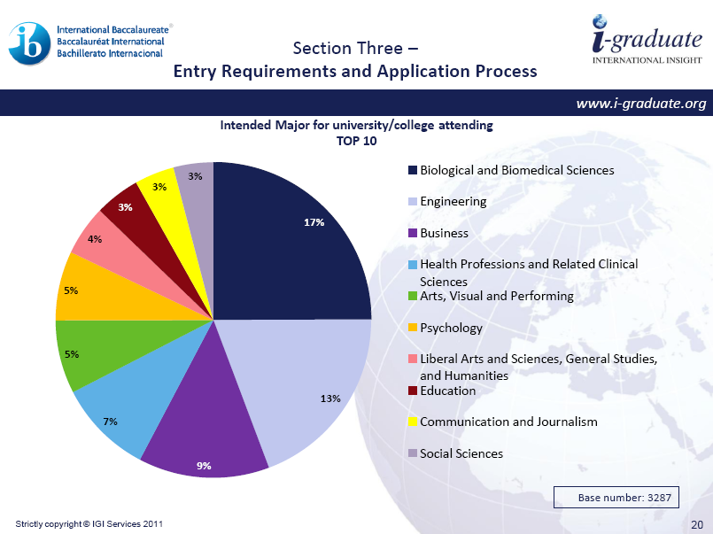

Slide 16
So how is the IB doing in Michigan?
“Michigan has more candidate IB programs (43) than any state in the country, or for that matter, any country except US and Canada”
Paul Campbell
Head of Regional Development
IB Americas

Slide 17
How Many World Schools in Michigan?
PYP 16
MYP 22
DP 24
A total of 62 programs

Slide 18
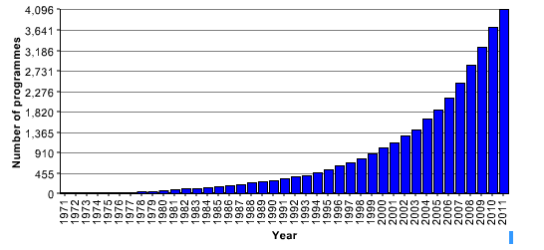
How Many IB World Schools

Slide 19
Questions?
Presentation available at:
Ibsom.org
Richard Perry Ed.D.
President, IB Schools of Michigan
Superintendent, Portage Public Schools
rperry@portageps.org

